Slide 1
Music recommendation system
GROUP NUMBER:4

Slide 2
TEAM MEMBERS:
PIRAI SOODAN G– CB.EN.U4CCE21045 ARNAV– CB.EN.U4CCE21008

Slide 3
SUB-TOPICS
Introduction
Objective
Problem Identification
Abstract
Methodology​

Slide 4
Introduction
Music recommendation projects aim to provide personalized song or music suggestions to users based on their preferences and listening history.
These projects utilize various techniques from Artificial Intelligence and Machine Learning (AI/ML) to analyze and understand user preferences, as well as the characteristics of different songs or music tracks.
In this project, the system collects data on user interactions, such as the songs they listen to, like, or skip. This data is then used to train a recommendation model, which can be based on algorithms like k-nearest neighbors , support vector machine , Decision tree , random forest models. The model learns from the patterns in the data to generate accurate recommendations.

Slide 5
Abstract
This is done by This paper explores using machine learning models to build music recommendation systems that can analyze songs and suggest recommendations tailored to a user's preferences and listening history. The researchers evaluate multiple models including KNN, SVM, Random Forest, and Decision Tree. The feature vectors used characterize different aspects of the songs like tempo, rhythm, and melody, which helps measure similarity between songs using Euclidean distance. The system divides the songs by genre and emotion to match recommendations on these attributes. The models are evaluated based on criteria like accuracy, confusion matrix, ROC curve, and learning curves. The results show that Random Forest achieved the highest accuracy due to its ability to handle complex high-dimensional data, capture nonlinear relationships, provide feature importance for interpretability, and efficiently handle large datasets. The researchers concluded that Random Forest is the most suitable model for developing an accurate and effective music recommendation system based on this song dataset.

Slide 6
Problem identification:
When a new user joins the platform or a new song is released, the recommendation system may struggle to provide accurate suggestions due to a lack of historical data.

Slide 7
Objective
The main objective of a music recommendation system is to enhance the user experience by providing personalized and relevant music suggestions. the primary objectives of a music recommendation system
Personalization
Efficiency
Accuracy
Adaptability
User Satisfaction
Enjoyable

Slide 8
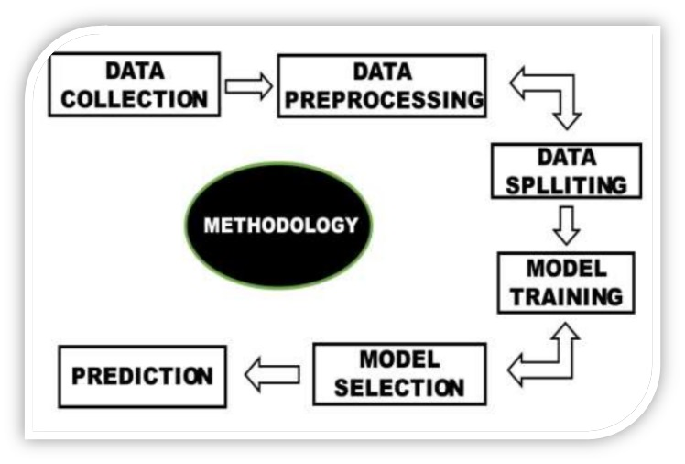
Methodology

Slide 9
THANK YOU

